Slide 1
Ebel Strategie
by Manu House

Slide 2

Manu House
Selfpublisher
Crypto Adviser
Investor
Youtuber
Nerd

Slide 3
Get involved into crypto in 2016
Get scammed in 2017 and loses about 50k Euro.
Idiot------------>
Realising that i need a plan to be successful.
I read a lot of books bitcoin and blockchain
Joining Seminars about cryptografie and blockchain.
I developed a strategy to play the market over the next years (15 years)

Slide 4
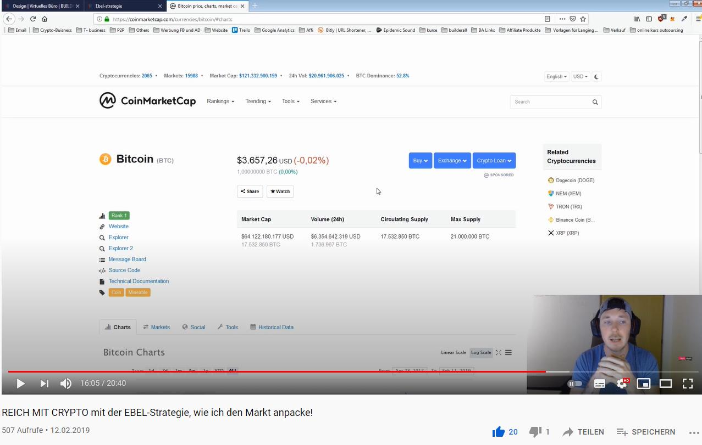
Evidence based emotionless strategie
Free on youtube since 2019
Video uploaded close to the bottom.

Slide 5
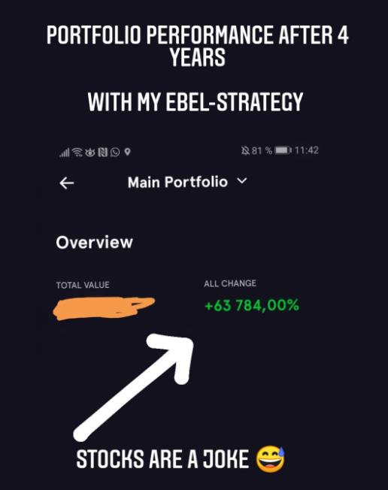
Mai 2021
4 years later:
Portfolio gains about 64000%
16000% in every year.

Slide 6
Breaking it down so everybody can understand

Slide 7
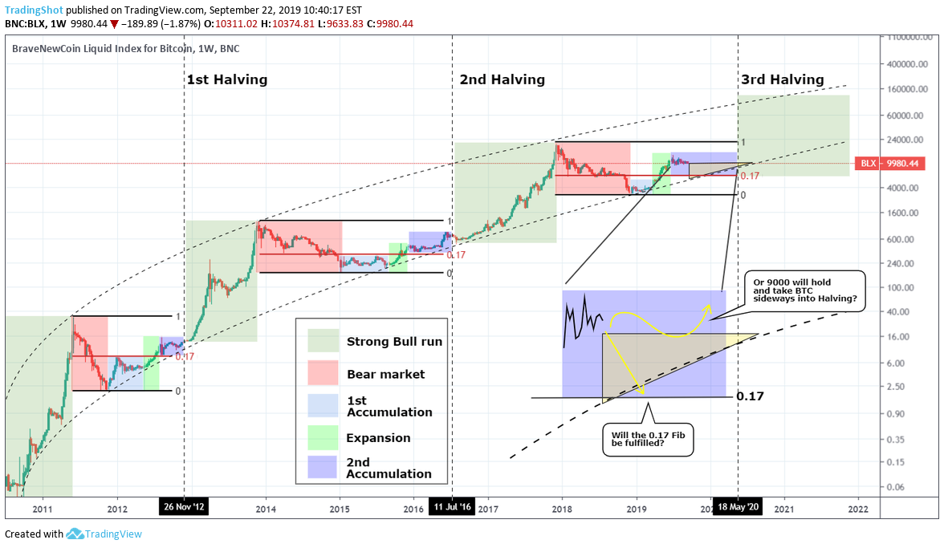
Market Cycles

Slide 8
Evidence based decision making
Where is the bottom? When to buy? (Bitcoin - leads the market)
After a 75-80 % correction from the top.
ALTS - 90-98 %
You can time the bottom!
Where is the top? When to sell? (Bitcoin - market follows)
You can't time the top!

Slide 9
evidence based
Bull Run 2017 - from bottom to top 1600%
the cycles are decreasing in potential up and downside.
Expectation Bull Run 2021 50% - around 800 % gain.
Leads to a potential price top of 160000 Dollar pro BTC.
Will it happen? Nobody knows.
You can't time the top, don't try it!!!!!

Slide 10
Cash out on psychological levels
Gameplan to get the gains out:
I start at 100 k slowly get into stablecoins.
Till 150 k 40-50% of my portfolio is already out.
Sell every Altcoin and 70% of my BTC.
30 % of my BTC i never sell!

Slide 11
Timeline:
End of 2021 - selling everything (keep 30% btc for the long term)
2022 - Start of the Bear Market
Lock at the % decrease of BTC
End of 2022-2023-beginning 2024 - Buy in back
2024 - halving
2025 Bullrun

Slide 12
Q and A

